Slide 1


Expert Hacks:
Cracking the Data Science Interview
Anish Mahapatra | 9 May 2023

Slide 2

Agenda
01
Introduction
02
Why choose Data Science?
03
Roles in Data Science
04
Move into Data Science
05
Strategies to transition (mind-maps)
06
Expert Hacks
Notes:
Expertrons Company Profile: Valuation & Investors | PitchBook

Slide 3











Topic 1 of 6
Introduction: Am I worth your time?
Mentored over 2000+ people in Data Science
Senior Data Scientist at a Global Fortune 200
Writer, Teacher, Webinar Expert in Data Science
Consultant to 7+ Fortune 500 companies
Subject Matter Expert in multiple Data Science Topics including Chatbots, Kafka, ML & AI
PGD from IIIT Bangalore + MSc in Data Science
6 years of experience in Data Science
Senior Data Scientist
LinkedIn: www.linkedin.com/in/anishmahapatra Medium: anishmahapatra.medium.com Website: www.anishmahapatra.com
GitHub: www.github.com/anishmahapatra
Q. How to get into Data Science?
A. Simple, ask a real-world Data Scientist.

Slide 4



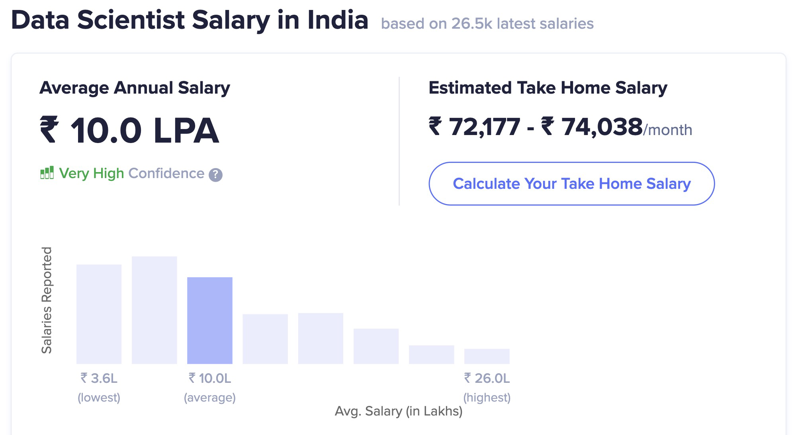


Topic 2 of 6
How can Data Science help in every Domain?
01
02
03
Relevance in the future
Business & Technology
Industry-Agnostic
Companies are building and growing in Data and it is the future.
Data Science is a combination of Business, Math and Technology, so growth can be in business / technology
Use your existing knowledge / domain / technology expertise with a data-edge
04
Extremely High Market Demand
Supply-Demand mismatch means companies are willing to pay more
Notes:
Source:https://www.payscale.com/research/IN/Job=Data_Scientist/Salary

Slide 5



Topic 3 of 6
Roles in Data Science
01
02
03
Data Engineer
Machine Learning Engineer
Business Analyst
Data Movement, Building Data pipelines, Quality of Data, Data Governance
Experimentation to get output, Modelling, Making the most out of data, Data Analytics
Client communication & management, Dashboarding & Reporting, Visualization, Decision Making
04
Data Scientist
Data on the cloud, modelling in all capacities, visualization, presentation to stakeholders, team management
Notes:
Source: https://databricks.com/blog/2020/08/03/modern-industrial-iot-analytics-on-azure-part-1.html

Slide 6












Topic 3 of 6
Tools & Technologies in Data Science
Data Engineer
Machine Learning Engineer
Business Analyst
Data Scientist

Slide 7
Topic 4 of 6
How to move into Data Science
01
02
03
Set Target
Talk to people
Build LinkedIn Profile
Understand the Data Field,
Understand roles & responsibilities,
Look at a 5-year path
Talk to people who are already doing what you want to do
Add certifications, participate in competitions, do simple projects, look at how the best of the best do it
06
05
04
Build Collaterals & Profile (30%)
Globally Accepted Degree (70%)
Explore Certifications
Multiple certifications don’t help, the quality of it does.
GitHub, LinkedIn,
Medium, Brand Profiling
Globally recognized degree, Degree Accepted by MNCs,
Possibility of PhD later,
Alumni Status
Bonus - WES Certification, Teachers from the industry
Notes:
All we care about is how to get a job, let me tell you how to leverage MSc to get a job!

Slide 8






Topic 4 of 6
Resume Optimization (Demo)

Slide 9
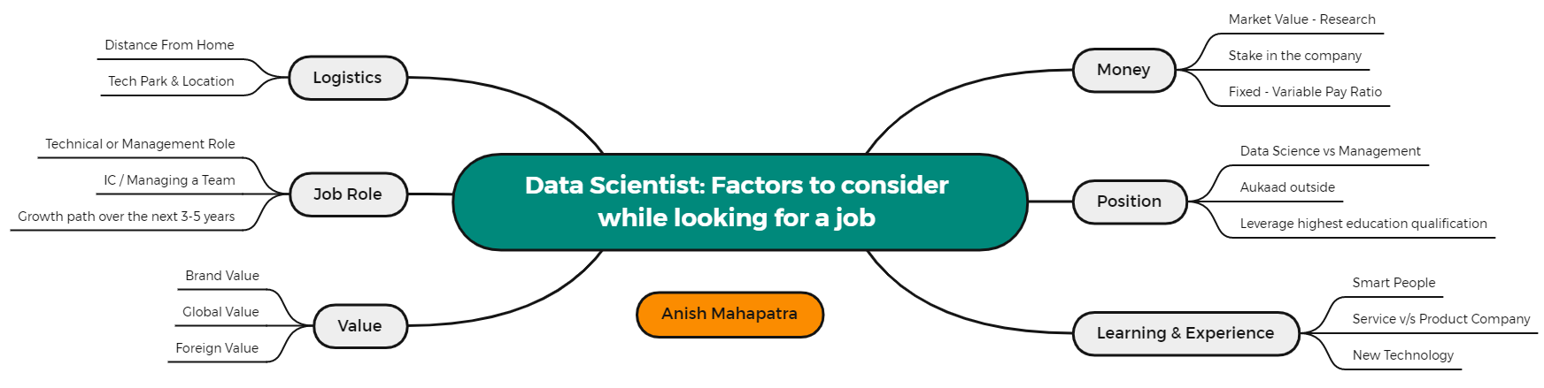
Topic 5 of 6
Factors to consider while looking for a job

Slide 10
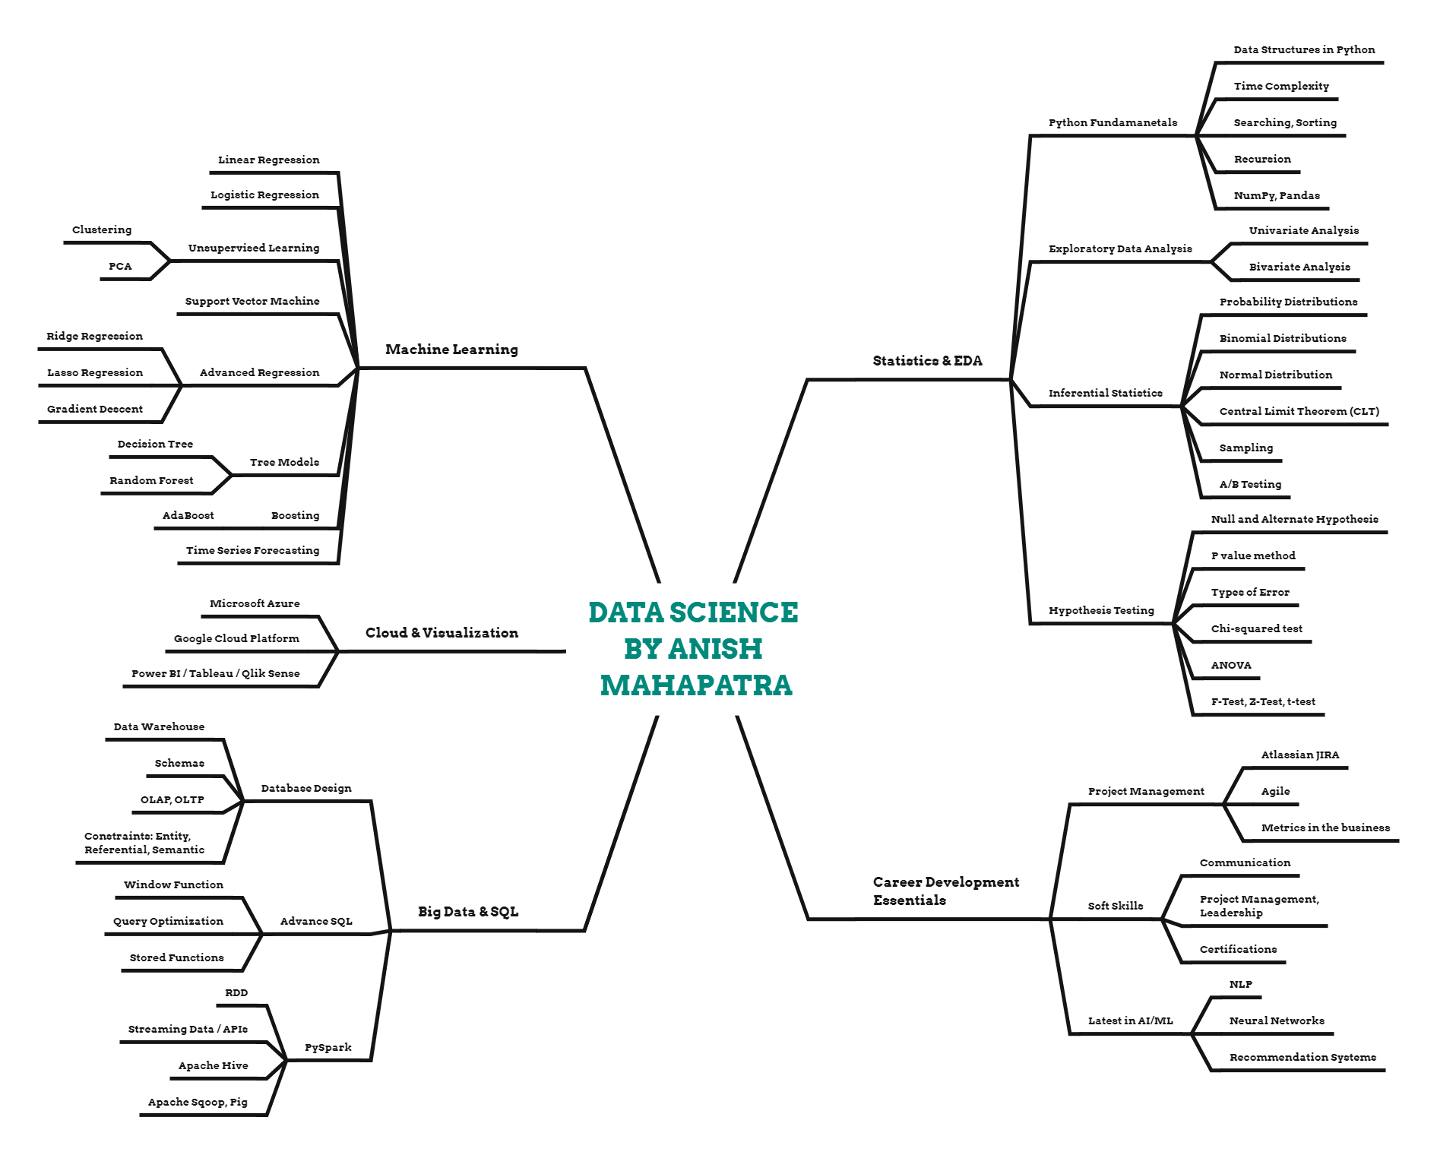
Topic 5 of 6
Plan your Data Science prep

Slide 11
Expert Hacks
01
Have Templates on Notion
02
Send Thank you Email after Interview
03
Have an Interview Tracker
04
Google Top 100 Interview Questions for Data Science, ML, SQL, Python
05
Have a Master’s Degree
06
Be Active & Proactive in replying
Notes:
Expertrons Company Profile: Valuation & Investors | PitchBook

Slide 12
Key Takeaways
01
Introduction - Anish Mahapatra
02
Why choose Data Science? - Highest ROI
03
Roles in Data Science - DE, MLE, BA, DS
04
Move into Data Science - Step-by-Step, Global Degree
05
Strategies to transition (mind-maps)
06
Expert Hacks - Pro-tips
Notes:
Expertrons Company Profile: Valuation & Investors | PitchBook

Slide 13

Expert Hacks:
Cracking the Data Science Interview
Anish Mahapatra
Q&A Session
LinkedIn: www.linkedin.com/in/anishmahapatra
Email: anishmahapatra01@gmail.com

Slide 14
Expert Hacks:
Cracking the Data Science Interview
Anish Mahapatra
Thank you.

